Slide 1
Examining the Efficacy of Virtual Reality for Learning Data Structures in Computer Science
By Matt Waterman

Slide 2
Quick Introduction
In this presentation, I’ll go over what I built for my honors project, and how it went!
I’ll give the basic context and purpose, a short summary of my literature review, go over the software, study design, and then the results from the study.
I’ll touch briefly on the limitations for this study, and how that can serve as context for future work in this space.

Slide 3
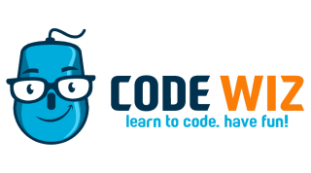

Context and Purpose
Computer Science education is something I've been passionate about for a long time.
Notes:
Computer Science education is something I've been passionate about for a long time. For a good portion of high school and even into college, I worked as a "coding coach" for Code Wiz, at which I taught kids to code, primarily focused on making video games.
Through my time there, I grew into my role not only as a teacher, but helping them expand as well. This meant I had to make content and learning modules for them, to give to other coaches, so I also have expertise with iterating on educational content.
Though I've since transitioned to another job, I haven't yet lost my expertise in delivering effective teaching materials, nor my passion for teaching computer science.
Through that job, the potential for virtual reality also became clear. Using Unity and the Quest headset, I ran summer camps, teaching kids how to code. I saw the value it had as an engaging environment for the kids, how much they enjoyed it, and the efficacy with which it helped them learn.
As a result, I wanted to investigate whether VR was useful as purely an environment for learning. Could content, if delivered in VR, outperform its traditional counterparts, even without modification? Does VR, on its own, offer benefits for learning outcomes? That is the central question for this study, and one I sought to answer with my honors project.

Slide 4
Literature Review
For the sake of respecting all of your time, I’m only going to touch briefly on Literature Review. If you’re interested in what I researched, the report will be available.
In short, I found a number of past studies on Virtual Reality and how it can be a tool for education, but only a small number of studies, and they each had their own drawbacks and idiosyncrasies.
Additionally, they showed that the idea I had for this study was fairly novel.

Slide 5
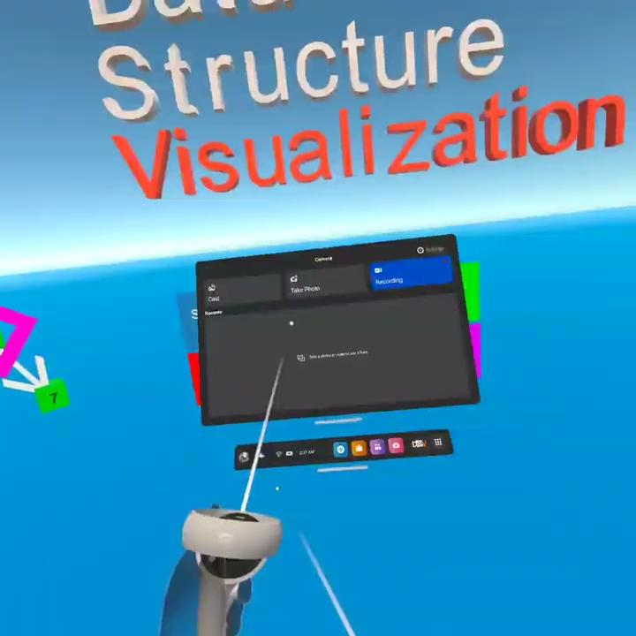
Demo

Slide 6
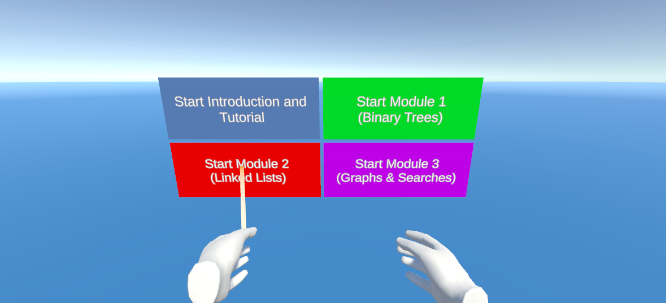
Purpose
I wanted to investigate whether virtual reality had benefits as a medium for education.
Notes:
Immediately, I wanted users to be engaged. I built a menu with dynamic animations, a clear title, and menu options that were easily accessible.
For the modules, I wanted to give people materials that they might have some familiarity with, but not something they were already likely to be experts in. For the content, I settled on teaching about Binary Trees, then Linked Lists, then Graphs and Searches.

Slide 7
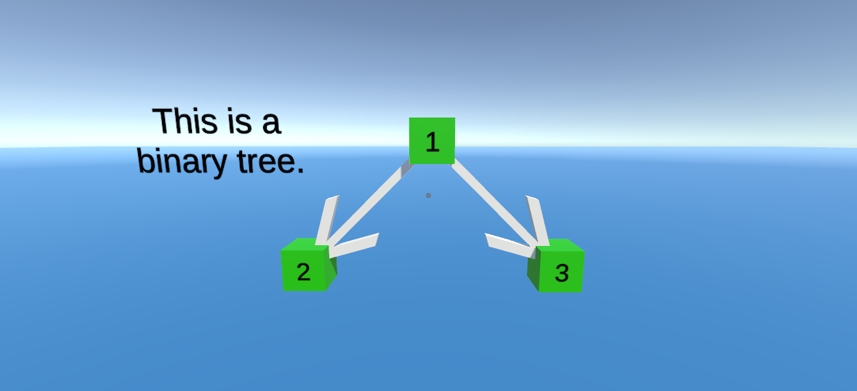
Content Development
Notes:
For binary trees, I wanted to keep it simple. No complex algorithms, just an introduction to the data structure.

Slide 8
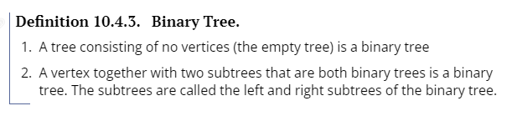
Content Development
Notes:
Initially, I looked at content I had already seen, or that had been used to teach me. In the demo, I provide the formal definition of a Binary Tree, which I got from my discrete structures class.

Slide 9
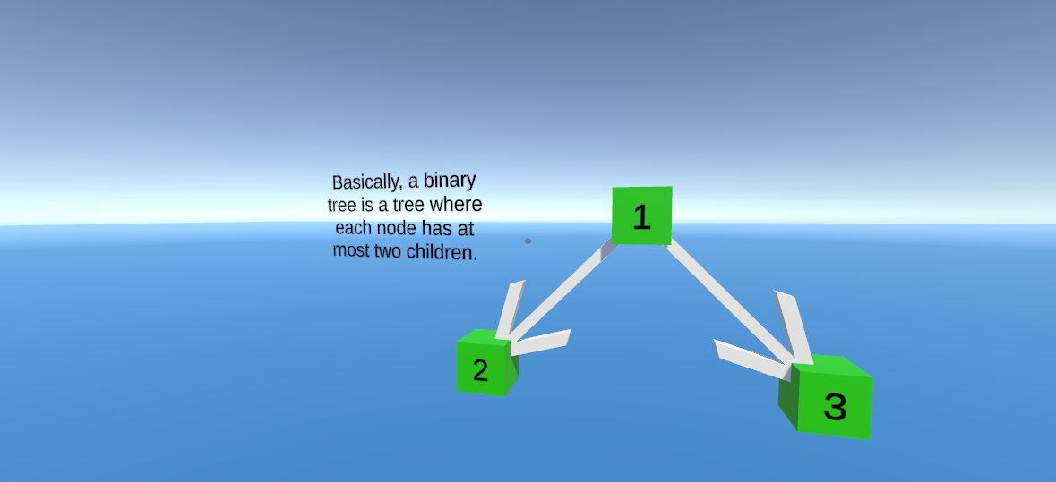
Content Development
Notes:
Though I can appreciate having a formal definition, and the need for rigor in an academic context, quickly, I moved to making the content much friendlier to the layman.

Slide 10
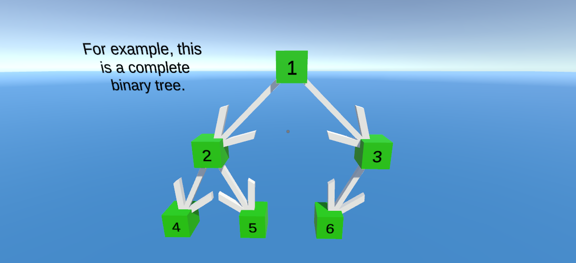
Content Development
Notes:
In the module, I wrote content to teach about the different properties of binary trees, and what it means to have a full, complete, and perfect binary tree.

Slide 11
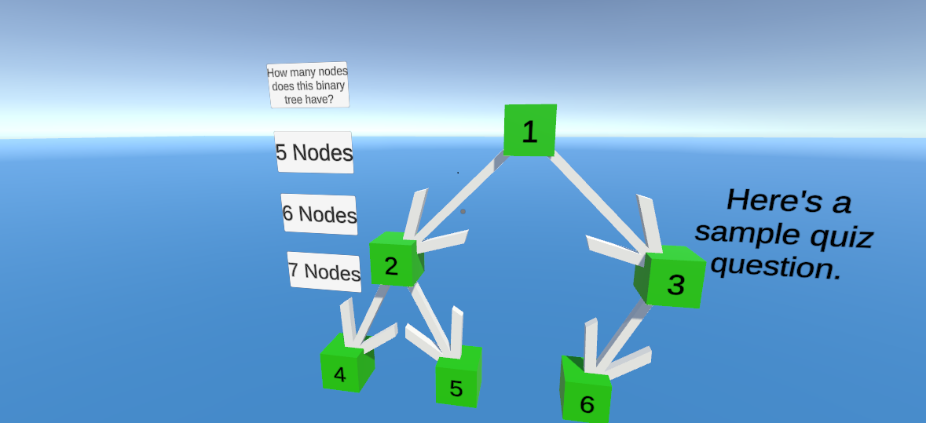
Content Development
Notes:
After, the participants proceed with an embedded assessment. First, they get a sample quiz question to familiarize them with the format.

Slide 12
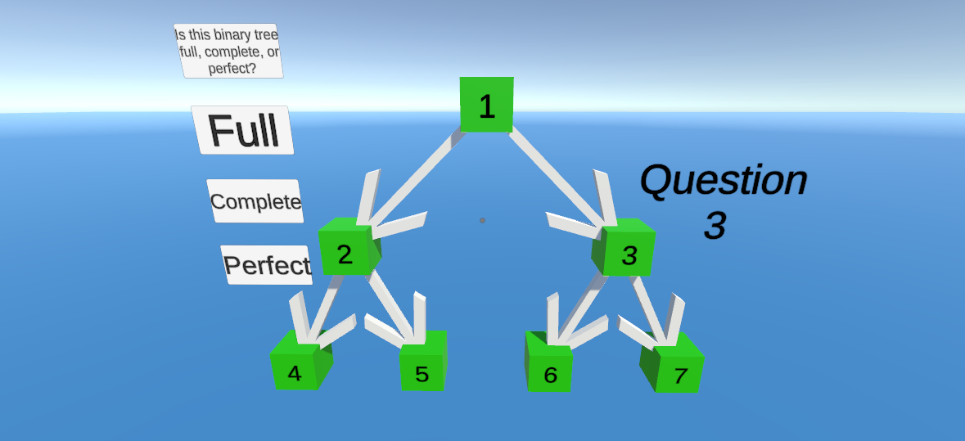
Content Development
Notes:
Then, students proceed through the actual content-related questions.

Slide 13
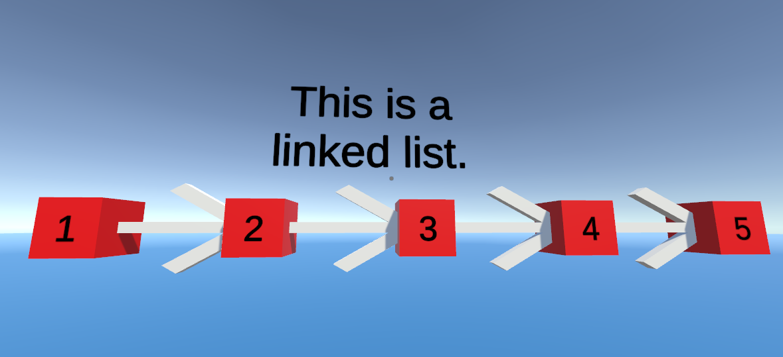
Content Development
Notes:
Once they've completed this, they'll move onto the module for Linked Lists. Now that they're familiar with the format, the content can get a little more complex. After a brief introduction to the concept of linked lists, they're presented with Linked List reversal.

Slide 14
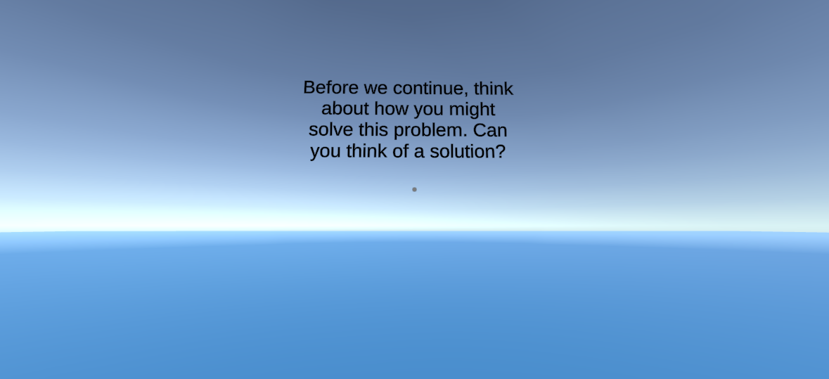
Content Development
Notes:
To keep students engaged, I have them try and think of a solution first. After this, they're presented with the "naive" and the "clever" solution for this problem.

Slide 15
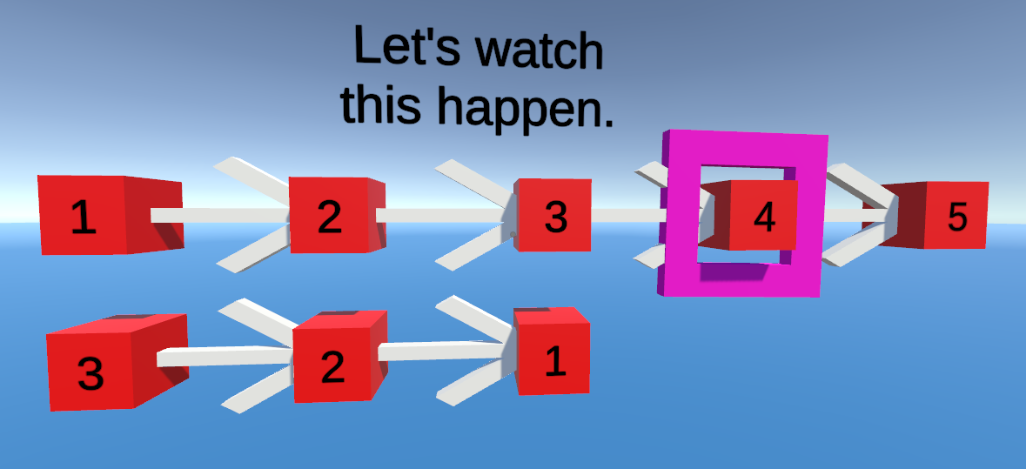
Content Development
Notes:
I also touch on complexity, as both are O(n) time, but O(n) and O(1) space complexity respectively.

Slide 16
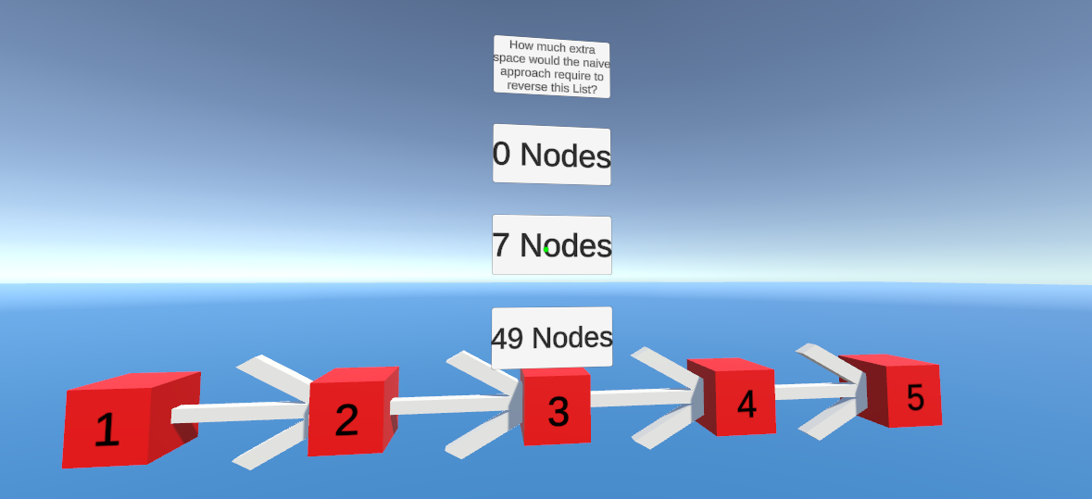
Content Development
Notes:
Again, students proceed through a sample quiz question, then the embedded assessment.

Slide 17
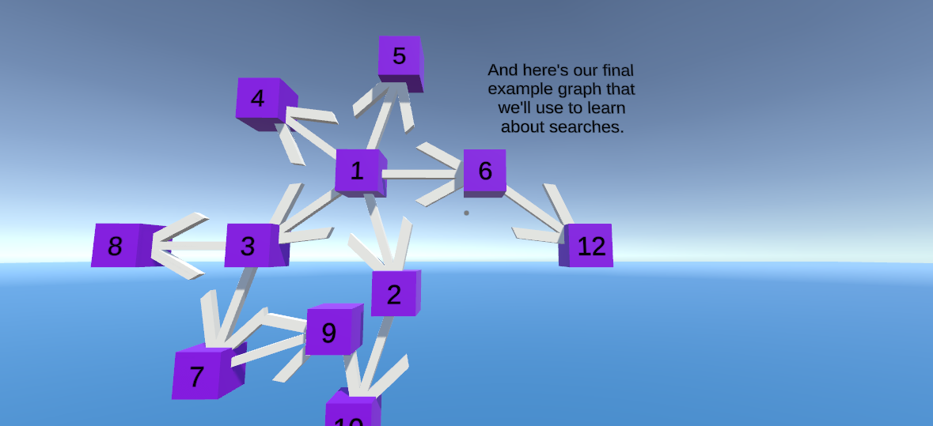
Content Development
Notes:
For the final module, there is both a dive into a data structure and relevant algorithms.

Slide 18
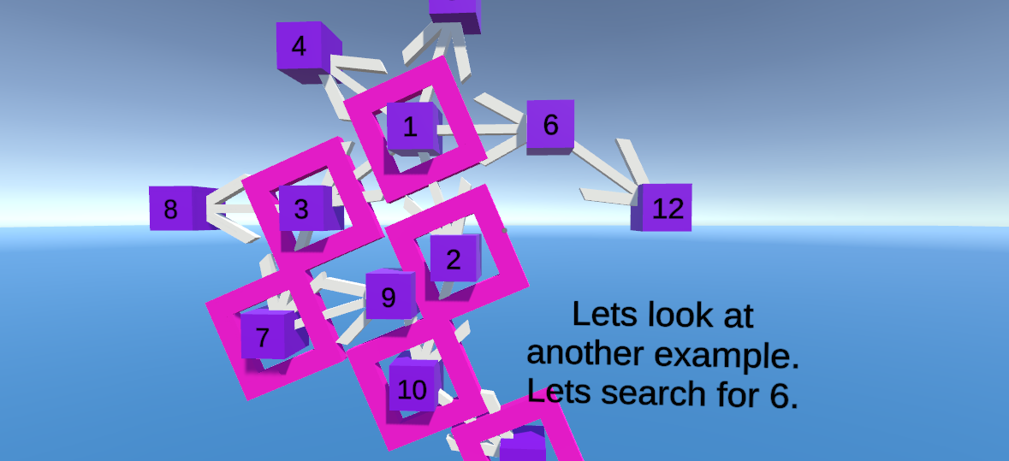
Content Development
Notes:
Participants learn about what a graph is, and then two different types of searches. They learn about the differences between depth and breadth first searches, and how different graphs and use cases can serve the different algorithms better.

Slide 19
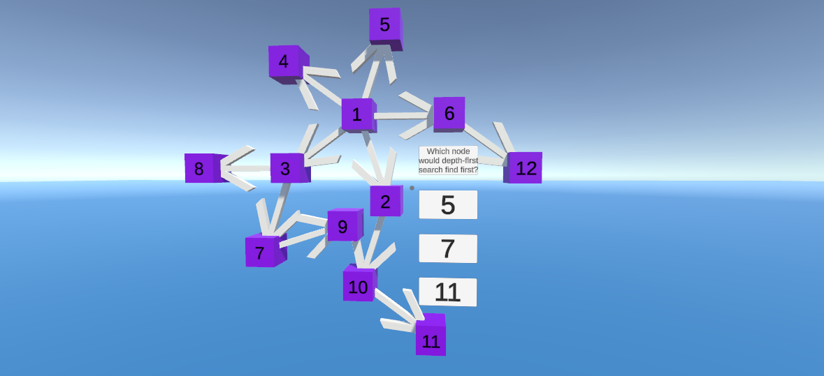
Content Development
Notes:
Of course, they then proceed to complete a final embedded assessment, testing their understanding of both searches

Slide 20
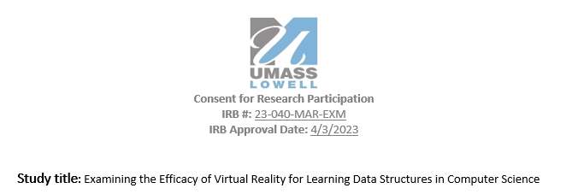
Study Design
Now that we're familiar with the structure of the software, we can fit it into the study design.
Notes:
Now that we're familiar with the structure of the software, we can fit it into the study design.

Slide 21

Study Design
Before participants complete any of the modules, they're given a study ID, to stand in for collecting any identifying information.
Notes:
Before participants complete any of the modules, they're given a study ID, to stand in for collecting any identifying information. Fortunately, this meant that I didn't have to collect any signed consent forms! Less paperwork for everyone involved is never a problem. More on the IRB approval process later, though.

Slide 22
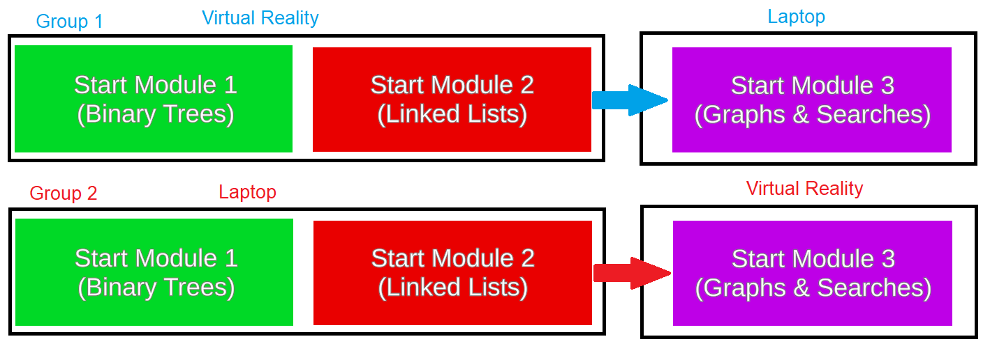
Study Design
Notes:
After a quick introduction, I would instruct them that they'd be completing the first two modules in one modality, and the last one in the other.

Slide 23
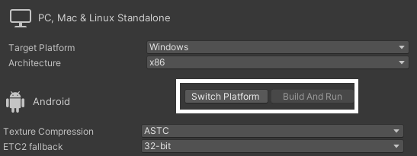
Study Design
Notes:
Participants were blind to the fact that some people were getting VR first and others got desktop first. Additionally, with a modality switch, every participant got some experience with VR. The idea of the study is that the content, other than the mode of interaction, is completely identical. Every line of text, every prompt, every quiz question is exactly the same. Due to some clever architecture work on my part, this became very easy.

Slide 24
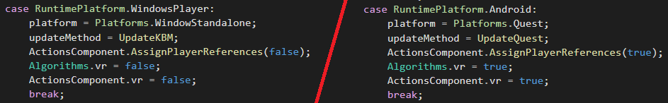
Study Design
Notes:
With simply switching the build target, and a simple if-statement on what platform is active, the input package would pick up and bind boiler plate code to the different devices.

Slide 25
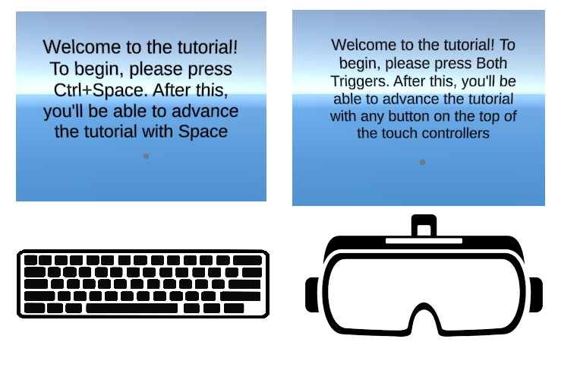
Study Design
Notes:
The introductory content is also adaptive.

Slide 26
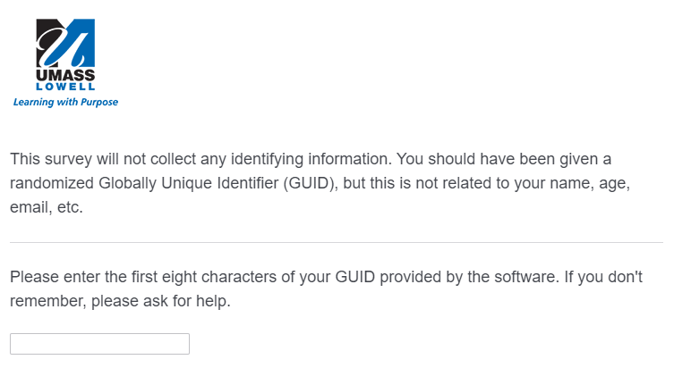
Study Design
Notes:
Since the different modalities obviously mandate different input mechanisms, the tutorial must adapt to that as well.
Once they've completed the introduction, and gotten a handle of the controls, they'll move onto the content. They'll complete the first two modules with the given modality, and swap for the other.
Finally, study participants take the post survey. The design of the post-survey was to collect some demographic info, and then to ask the user to compare their experiences with the two different versions of the software.

Slide 27
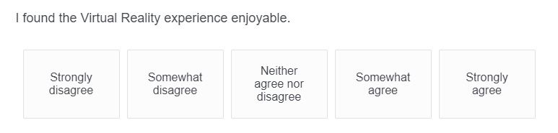
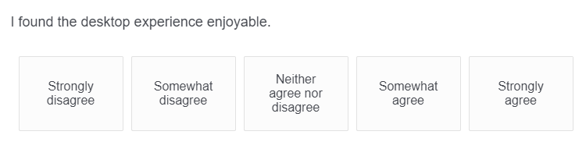
Study Design
Notes:
We also wanted to gather data on the subjective experience with the software. For both modalities, we asked the following questions:
Did you find it enjoyable?
Did you find it informative
Did you find it easy to use?
Finally, we included an open-response section, so that we could gather any other thoughts from the participants.

Slide 28
IRB Approval
Though the process was somewhat arduous, it was generally painless.
Many thanks are owed to Emily Sousa for her work helping prepare my submission.
Notes:
The results of these questions, as well as the embedded assessment was certainly interesting. Before we get to the results, though, it's worth touching on the IRB approval process.
The process to get this study approved was, though somewhat arduous, fairly painless. Thanks again to Emily Sousa for the work she put in to helping amend my submission and expedite the process.
I had to submit everything I intended to use, including recruitment materials, emails, a consent form, and the whole investigator study plan.
Fortunately, my recruitment materials were extremely effective! In just the first day, we had over forty interested participants, from emailing the Computer Science Mailing List alone. Even without the posters and outreach to the ACM/UMLCS discord servers, we ended up with about sixty interested participants. We only had the budget for twenty, but it's worthwhile to note the immediate and outsized interest in the participation for this study.

Slide 29
Results
These results are from the twenty study participants.
However, there were many more interested.
Even without the posters and outreach to the ACM/UMLCS discord servers, we ended up with about sixty interested participants.
We only had the budget for twenty, but it's worthwhile to note the immediate and outsized interest in the participation for this study.
Notes:
Alright, without further adieu, we'll get into the results.

Slide 30
Results
No rejection of the null hypothesis! :(
The mean results from the embedded assessment were nearly identical, at about 75% correct.
In fact, the mean score for the Linked List modules was exactly identical, with the exact same number of total correct answers between the two groups.
This, fairly conclusively, shows that Virtual Reality - in and of itself - does not offer benefits to learning outcomes.

Slide 31
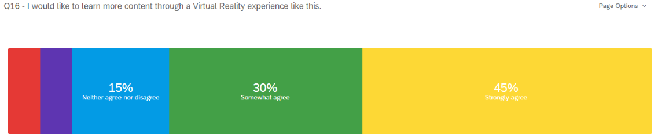
Results
The only statistically significant differences observed were with the results on enjoyability.
These results were tested by the Mann-Whitney U test, which is a test for ordinal data. According to that test, our results for “I would like to learn more content through Virtual Reality/Desktop” are statistically significant.

Slide 32
Results
Otherwise, the data was not statistically significant with a p-value under 0.05. However, the open-feedback responses are still certainly informative. We heard that:
"I feel like it was more engaging to me to be in VR. helps me focus"
"I really enjoyed the VR and to treat it as a game in a sense."
"I think that learning about data structures in VR was very informative and far more enjoyable then learning about them on the desktop experience."

Slide 33
Limitations; Context for Future Work
The modules were identical in content.
“The VR experience felt like it was just the desktop version ported over to VR instead of something purpose-built to take advantage of VR.”
Notes:
For experienced Virtual Reality users, the modules didn't use the capacities of the medium enough. Originally, the software was intended to be a sandbox, in which you could move around, create new nodes, link them together, organize data structures, run algorithms, and so on. Though the functionality is there, it became clear throughout the testing that any tutorial that could introduce a non-experienced user to these tasks would rapidly exceed the target time for even the whole activity. Consequently, future work that discards the need for content to be exactly identical, and instead allows VR users to attain much deeper interaction with the learning materials may yet result in the better learning outcomes we sought in this study.

Slide 34
Limitations; Context for Future Work
2. The target time was short.
With a much longer engagement per user, and full time for acclimatization to the environment, it is possible that differences could emerge.
Notes:
One clear difference we noticed between some of our participants was their familiarity with VR. For users that often use VR, or even more so have a headset themselves, progressed through the tutorials and learning modules remarkably faster than those who didn't. Though time to complete was not a measured factor, it is sensible that this is the case.

Slide 35
Limitations; Context for Future Work
3. This study tested things students already knew to some degree
Notes:
For experienced Virtual Reality users, the modules didn't use the capacities of the medium enough. Originally, the software was intended to be a sandbox, in which you could move around, create new nodes, link them together, organize data structures, run algorithms, and so on. Though the functionality is there, it became clear throughout the testing that any tutorial that could introduce a non-experienced user to these tasks would rapidly exceed the target time for even the whole activity. Consequently, future work that discards the need for content to be exactly identical, and instead allows VR users to attain much deeper interaction with the learning materials may yet result in the better learning outcomes we sought in this study.

Slide 36
Limitations; Context for Future Work
4. Students said VR was more engaging.
As mentioned before, participant testimonials included a number of reports that VR was more immersive, helped people focus, and was overall more fun.
Notes:
As mentioned above, participant testimonials included a number of reports that VR was more immersive, helped people focus, and was overall more fun.
Though hard to quantify, consistently they reported that VR was more fun and engaging. Keeping students engaged is an unending challenge for educators, and virtual reality seems that it may offer benefits in this area. This may be partially because of the novelty of VR, which may wear off with longer intervention. Again, worth further investigation.

Slide 37
Limitations; Context for Future Work
The clear potential for extending the scope, the reported engagement by students, and the relative lack of research in this area all necessitates future study.
Notes:
Consequently, the context for future studies is as follows. If we had access to infinite time, willing participants, and budget, the study design would basically be a significantly scaled version of this study.
Over the course of a semester or long time frame course, students could be separated into two groups. One would receive content in Virtual Reality, the other traditional materials. These materials could have some different activities, while covering the same conceptual content.
Retaining a modality switch could also still provide useful insight. With a long time frame, one could evaluate the differences in the pre-post swap. If students improved after switching to VR, and/or got worse after switching to traditional materials, that serves as further evidence for this phenomenon.
Regardless, the clear potential for extending the scope, the reported engagement by students, and the relative lack of research in this area all necessitates future study.

Slide 38
Conclusion
Though in this case, we failed to reject the null hypothesis, the process and data were still instructive. We accomplished about as much as is possible in a one-semester project, and received unprecedented interest in the study.
I have deeply enjoyed the process of creating, refining, and testing this software, and I hope that the results that we found will be of use to further research!

